Slide 1

2020 2nd International Conference on Sustainable Technologies
for Industry 4.0 (STI), 19-20 December, Dhaka
Poster ID- 245
A STUDY ON SCATTERING AND ABSORPTION CROSS-SECTIONS OF GOLD NANOSPHERE FOR OPTIMUM OPTICAL EFFICIENCY
Md. Amzadul Hoque Chowdhury, Md. Shah Kamal, Md. Fakhrul Alam, Md. Masud Rana
Department of Biomedical Physics & Technology, Department of Electrical & Electronic Engineering, University of Dhaka
Department of Electrical, Electronic & Communication Engineering, Military Institute of Science & Technology,
Department of Mechanical & Production Engineering, Ahsanullah University of Science & Technology.

Slide 2
ABSTRACT
The poster presents a study on scattering and absorption cross section of gold (Au) nanosphere using Nanosphere optics lab simulator. The scattering and absorption cross-sections with respect to wavelength have been calculated. It has been found that absorption efficiency increases for Au nanosphere with the increase of refractive index of the surrounding medium. The scattering efficiency is also found to increase with the increase of refractive index of the medium until the efficiency reaches its peak value for an index of 3.5. Any further increment of the refractive index results in the decrease of scattering efficiency. Another interesting finding is that the peak value of the scattering and absorption efficiencies for Au nanosphere shifts to higher wavelength. Maximum optical efficiency has been achieved by analyzing nanospheres of various radii. For Au nanosphere the absorption efficiency is found to be 15.204% for 10 nm radius when the refractive index is 3.927 and the scattering efficiency is found to be 11.383% for 20 nm radius when the refractive index is 3.42. These optical properties can be used for enhancing absorption and scattering efficiency in solar cells and photodetectors respectively.
2020 2nd International Conference on Sustainable Technologies
for Industry 4.0 (STI), 19-20 December, Dhaka

Slide 3
INTRODUCTION & LITERATURE REVIEW
The optical properties of nanoparticles are important for both traditional and emerging technologies. Today, metallic nanoparticles are used in commercial coatings that absorb at particular solar wavelengths. Recently, the optical absorption of noble metal nanoparticles has been employed as the basis for novel sensors: the enhanced local fields close to particle surfaces makes it possible to detect single molecules by surface-enhanced spectroscopy [1].
Metallic nanoparticle and nanostructures exhibit Surface Plasmon Resonance (SPR), which is the coherent excitation of entire free electrons in the conduction band producing an in phase oscillation. Under resonance, light is tightly to the surface of the nanostructure, unit it gets eventually absorbed inside the metal or scattered back into photons [2].
Au nanoparticles have some unique optical and electronic properties that are being researched and utilized in high technology applications such as organic photovoltaics, sensory probes, therapeutic agents, drug delivery in biological and medical applications, electronic conductors and catalysis. The optical and electronic properties of gold nanoparticles are tuneable by changing the size, shape, surface chemistry, or aggregation state. Gold nanoparticles interaction with light is strongly dictated by their environment, size and physical dimensions[3].
Strong SPRs are also observed for Au nanoparticles that can be tuned by varying the size or shape of nanoparticles, leading to particles with tailor optical properties for different applications. Different other nanostructures based on Au are also being analysed to be used for various application. Au based nanowire shows promising features for photovoltaic (PV) application due to their SPRs [4].
2020 2nd International Conference on Sustainable Technologies
for Industry 4.0 (STI), 19-20 December, Dhaka

Slide 4
MODELLING AND SIMULATION
Nanosphere optics lab simulator is used for modelling and simulation which uses Mie theory for most of calculations [5].
A. Simulation parameters
1. Particle composition
2. Particle refractive index
3. Surrounding medium refractive index
4. Radius of particle
B. Parameter description and conditions
1. Au nanosphere for particle composition.
2. Particle refractive index varies from 1 to 2.
3. Surrounding medium refractive index varies from 1 to 5.
4. Radius of particle has a range of 10 nm to 1000 nm
2020 2nd International Conference on Sustainable Technologies
for Industry 4.0 (STI), 19-20 December, Dhaka

Slide 5
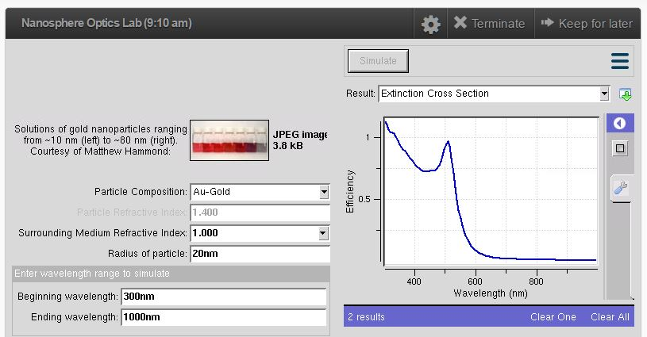
MODELLING AND SIMULATION
Fig. 1: Nanosphere optics lab simulator
2020 2nd International Conference on Sustainable Technologies
for Industry 4.0 (STI), 19-20 December, Dhaka

Slide 6
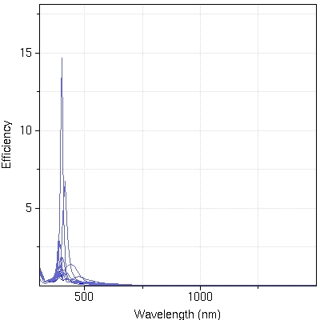
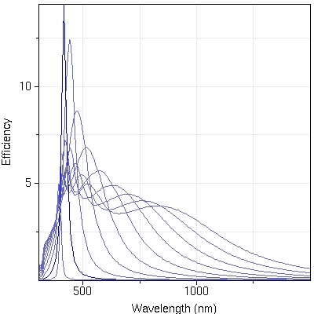
RESULTS AND ANALYSIS
Fig. 2: (a) Absorption efficiency maximum at 10 nm radius (11.418%) for ZnO medium, second peak found at 20nm (7.259%). First peak is found at 638.37nm and second one is found at 673.47nm wavelength. (b) Scattering efficiency maximum at radius 30nm (10.07%) for ZnO at 720.28nm wavelength and second highest is for 20nm radius (9.993%) at 673.47nm wavelength. With the increase of radius, the peak covering area of wavelength also increased.
2020 2nd International Conference on Sustainable Technologies
for Industry 4.0 (STI), 19-20 December, Dhaka

Slide 7
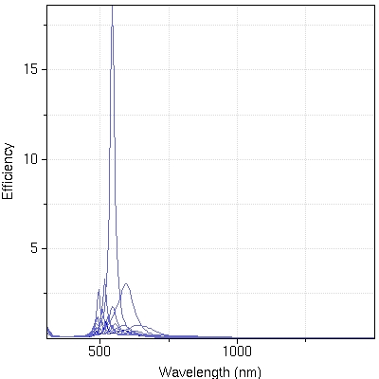
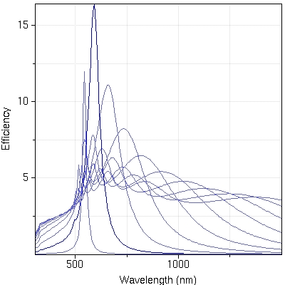
RESULTS AND ANALYSIS
Fig. 3: (a) Absorption efficiency maximum at 10 nm radius (15.104%) for Si medium, second peak found at 20nm (5.479%). First peak is found at 813.89nm and second one is found at 884.1nm wavelength. (b) Scattering efficiency maximum at radius 20nm (11.383%) for Si at 878.25nm wavelength and second highest is for 30nm radius (9.295%) at 966.01nm wavelength. With the increase of radius, the peak covering area of wavelength also increased. After 30nm we get 2 peak for rest of the radius.
2020 2nd International Conference on Sustainable Technologies
for Industry 4.0 (STI), 19-20 December, Dhaka

Slide 8
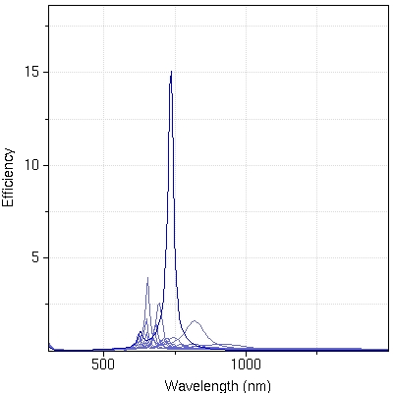
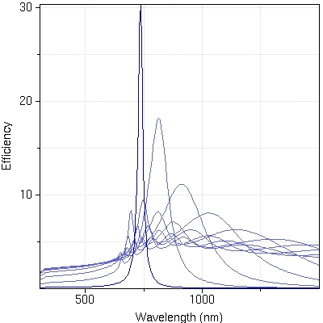
RESULTS AND ANALYSIS
Fig. 4: (a) Absorption efficiency maximum at 10 nm radius (15.204%) for GaAs medium, second peak found at 20nm (5.5203%). First peak is found at 907.51nm and second one is found at 995.27nm wavelength. (b) Scattering efficiency maximum at radius 20nm (10.303%) for GaAs at 989.42nm wavelength and second highest is for 30nm radius (8.804%) at 1088.88nm wavelength. With the increase of radius, the peak covering area of wavelength also increased. After 30nm we get 2 peak for rest of the radius.
2020 2nd International Conference on Sustainable Technologies
for Industry 4.0 (STI), 19-20 December, Dhaka

Slide 9
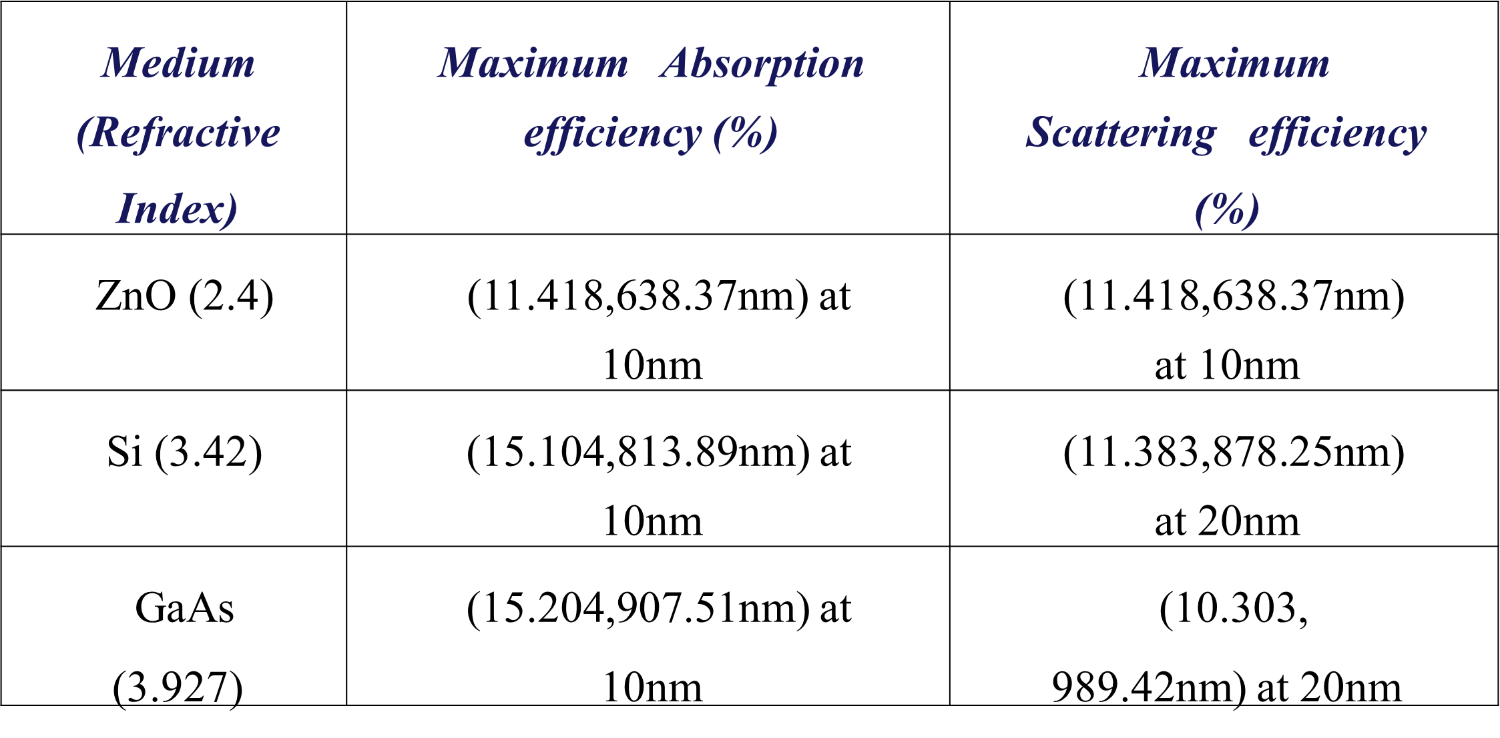
RESULTS AND ANALYSIS
Table 1. Result analysis from graph for Au nanosphere
2020 2nd International Conference on Sustainable Technologies
for Industry 4.0 (STI), 19-20 December, Dhaka

Slide 10
CONCLUSIONS
With the increase of medium refractive index absorption efficiency increased another noticeable thing is that for maximum absorption value the radius of nanosphere also decrease. For scattering efficiency same thing is observed, that scattering efficiency increases with the increase of medium refractive index but for GaAs, scattering efficiency slightly decrease. Radius of nanosphere decrease with the increase of medium refractive index. For every medium refractive index, we got peak at different wavelength, both case for absorption and scattering efficiency it is clear that maximum value shifted from left to right of wavelength with the increase of medium refractive index. For gold nanosphere the absorption efficiency is found to be 15.204% for 10 nm radius when the refractive index is 3.927 and the scattering efficiency is found to be 11.383% for 20 nm radius when the refractive index is 3.42. These optical properties have a vast field of application. Absorption and scattering efficiency can be enhanced by using nanospheres. These nanosphere in solar cell, photodetector, sensors and a wide range use in biomedical field.
2020 2nd International Conference on Sustainable Technologies
for Industry 4.0 (STI), 19-20 December, Dhaka

Slide 11
REFERENCES
[1] Stephenson, C.; Hubler, Stability and conductivity of self-assembled wires in a transverse electric field. Scientific Reports Vol. 5, 15044 (2015)
[2] H. Xu, E.J. Bjerneld, M. Kall, L. Borjesson. Spectrocopy of Single Hemoglobin Molecules by Surface Raman Scattering. Phys. Rev. Lett. 83, 4357 (1999)
[3] Alyssa B. Zrimesk, Nolan L. Wong, and Richard p. Van Duyne. Single Molecule Surface Enhancement Spectroscopy: A critical Analysis of the Bianalyte versus Isotopologue. Journal of Physical Chemistry C 120 (9), 5133-5142 (2016)
[4] Cecilia Noguez. Surface Plasmon on Metal Nanoparticles: The Influence of Shape and Physical Environment. Journal of Physical Chemistry C 111 (10), 3806-3819 (2007)
[5] N.L. Dmitruk, S.Z. Malynych, I.E. Moroz, V.Yu. Kurlyak, Optical Efficiency of Ag and Au Nanoparticles. Semiconductor Physics, Quantum Electronics & Optoelectronics. V. 13, N 4. P369-373 (2010)
[6] Qiang Fu and Wenbo Sun. Mie Theory for Light Scattering by a Spherical Particle in an Absorbing Medium. Appl. Opt. 40, 1354-1361 (2001)
2020 2nd International Conference on Sustainable Technologies
for Industry 4.0 (STI), 19-20 December, Dhaka

Slide 12
Thank You
2020 2nd International Conference on Sustainable Technologies
for Industry 4.0 (STI), 19-20 December, Dhaka

